Slide 1
Digital Lab 2 Project
Names | ID
Mohamed Hassan Hassan Khalil | 18011433
Mohamed Nasser Mohamed Amr | 18011633
Ali Ramadan Ramadan Younes | 18011079
Mahmoud Ahmed Ali Ahmed Omara | 18011657
Mohamed Emad Younes yehia | 18012503
Abanob Morkos Gad Elsaid | 18010004
Abdelrahman Saber Mohamed | 17011037
Mohamed Abdelsalam Abdelmotleb | 18011535

Slide 2
Part 1 : Inter-Symbol Interference due to band-limited channels

Slide 3
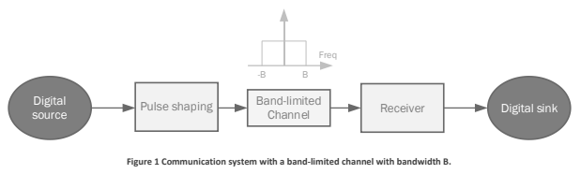
Part 1 : Inter-Symbol Interference due to band-limited channels

Slide 4
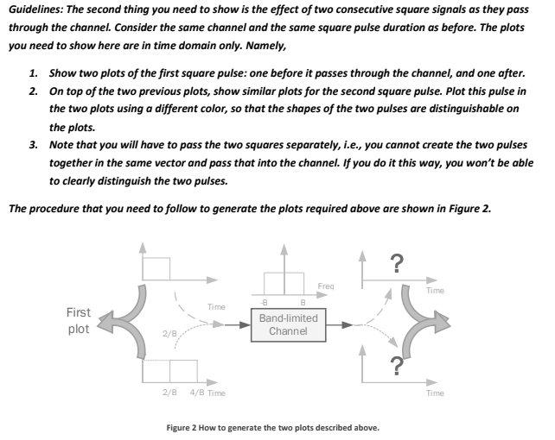
Part 1 : Inter-Symbol Interference due to band-limited channels

Slide 5

Part 1 : Inter-Symbol Interference due to band-limited channels

Slide 6
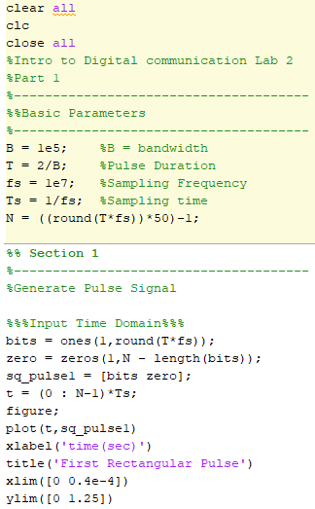
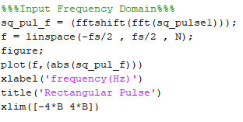
Part 1 : Inter-Symbol Interference due to band-limited channels
The Code and Results

Slide 7
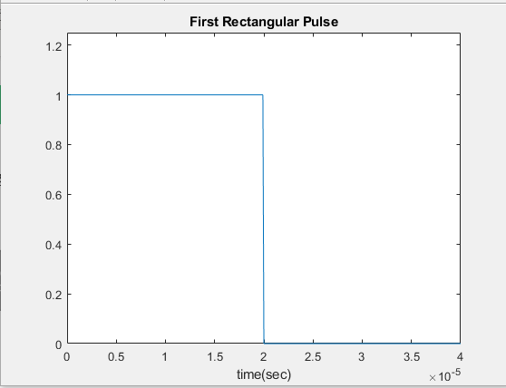
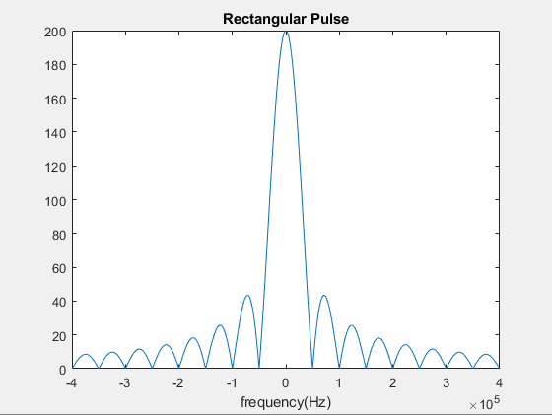
Part 1 : Inter-Symbol Interference due to band-limited channels
%%%%%%%%%Pulse in Time and Frequency Domains%%%%%%%%%%
Input Signal NRZ with 1/Tb High level and 1/Tb low level

Slide 8
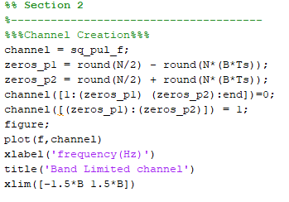
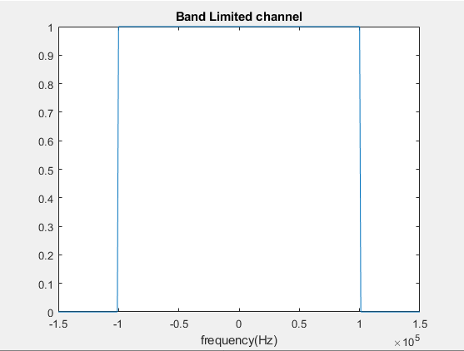
Part 1 : Inter-Symbol Interference due to band-limited channels
%%%Band Limited Channel ranged from –B to B Bandwidth%%%

Slide 9
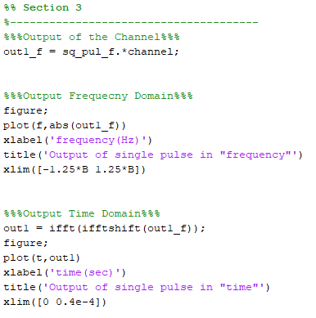
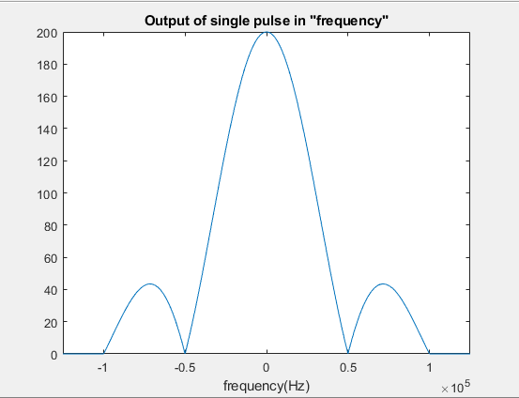
Part 1 : Inter-Symbol Interference due to band-limited channels
%%%After passing the Input through Band Limited channel Sinc function limited at – B and B%%%

Slide 10
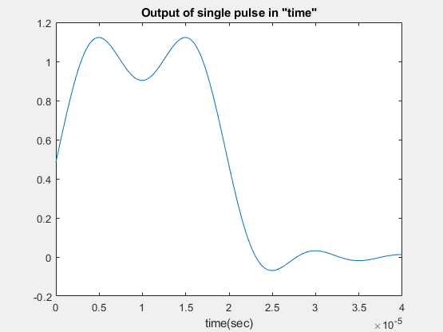
Part 1 : Inter-Symbol Interference due to band-limited channels
%%%Due to Channel the Message was distorted with ripples (in Time Domain)%%%

Slide 11
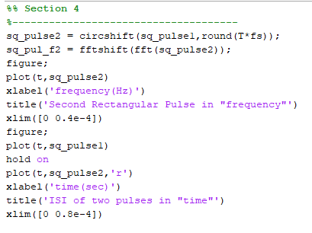
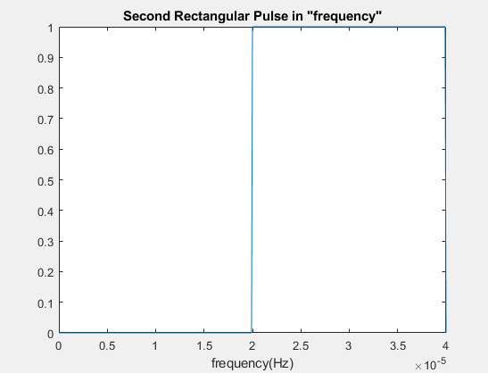
Part 1 : Inter-Symbol Interference due to band-limited channels
%%%Generation of the Second Pulse which follows the first one immediately (in Frequency domain)%%%

Slide 12
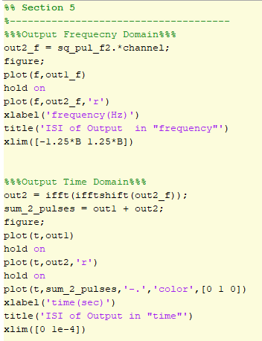
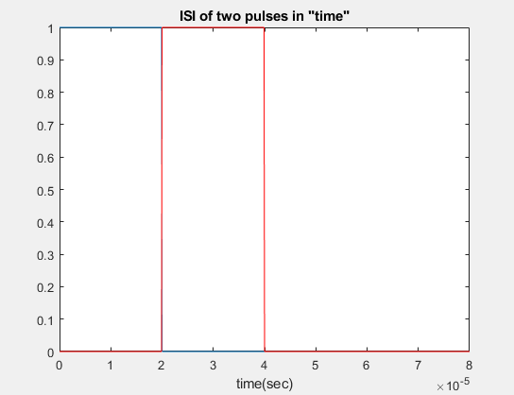
Part 1 : Inter-Symbol Interference due to band-limited channels
%%%Plotting The Two Pulses to make future operation on them (in time domain)%%%

Slide 13
Part 1 : Inter-Symbol Interference due to band-limited channels
%%%Plotting The Two Pulses to make future operation on them (in time domain)
To be clearer%%%
Second Pulse
First Pulse

Slide 14
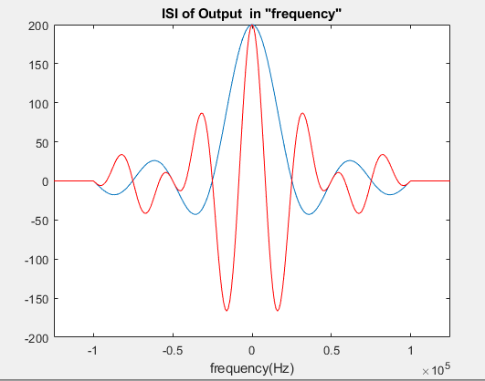
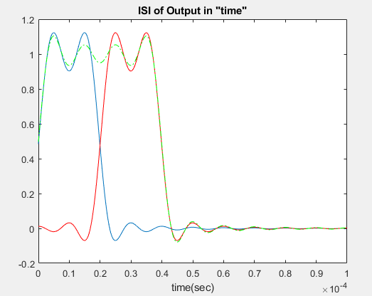
Part 1 : Inter-Symbol Interference due to band-limited channels
1
2
%%%Inter-symbol Interference Occurrence , here what we need?
We need that at point 1 for example to be the value of first pulse only and value of second pulse equals zero while at point 2 the value of second pulse only and value of first pulse equals zero but in reality, ISI occurred and resulted that many points have value of the two pulses.

Slide 15
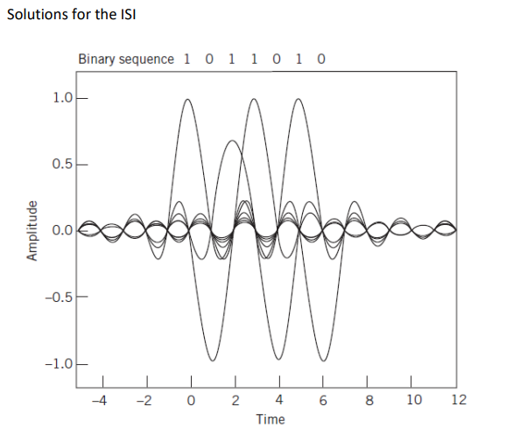
Part 1 : Inter-Symbol Interference due to band-limited channels
%%%From the Solutions of ISI %%%
**First method : If the generated signal is sinc function instead of square pulse where at the values shown(no.1) for specific sinc function there are zeros (no.2) for the other signals actually there are some very small values of other signals(no.3), but sill very low ISI compared to square pulse signal**
1
3
2

Slide 16
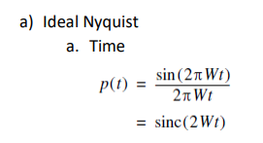
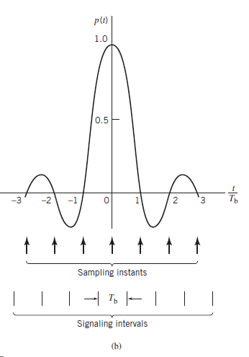
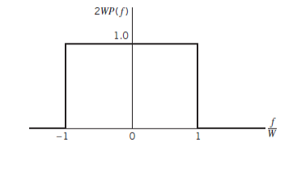
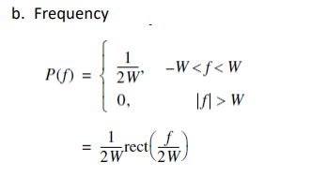
Part 1 : Inter-Symbol Interference due to band-limited channels

Slide 17
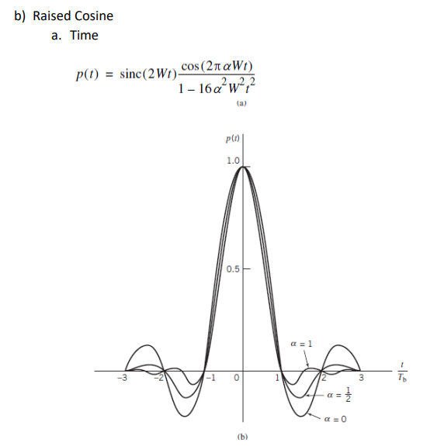
Part 1 : Inter-Symbol Interference due to band-limited channels
**Second method :
Same idea as sinc function, but the difference thing that we multiplied by factor which has variable (alpha) = roll off factor, this value @alpha = 0 it will be the (First method), but @alpha = 1 then ripples will vanish faster in which this method is much better than first method where the very small values which interfaces will be nearly equal to zero
Also there are additional NULLS appeared which is much better.

Slide 18
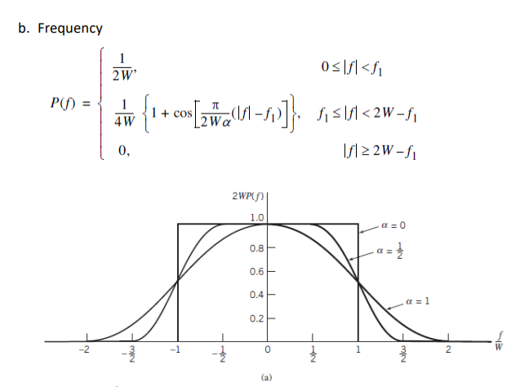
Part 1 : Inter-Symbol Interference due to band-limited channels

Slide 19
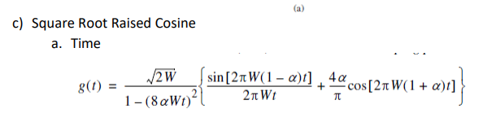
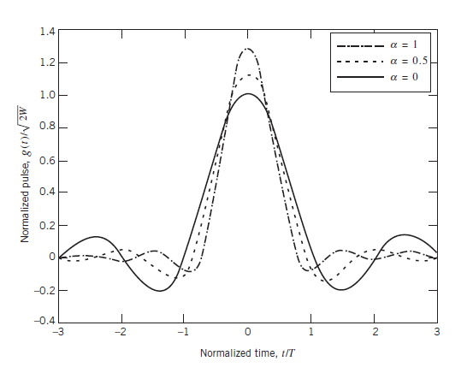
Part 1 : Inter-Symbol Interference due to band-limited channels
**Third method :
improve spectrum efficiency by more than 75% , but roll off factor can change the amplitude of the Signal in addition to the ripple decaying

Slide 20
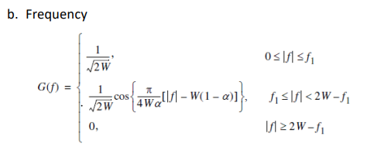
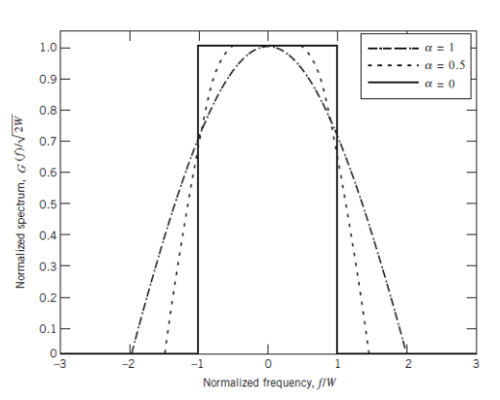
Part 1 : Inter-Symbol Interference due to band-limited channels
At roll off factor approaches to value 1 the curve approaches to cosine wave form

Slide 21
Part 2 : Inter-Symbol Interference due to multi-path channels

Slide 22
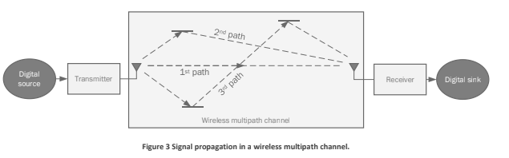
Part 2 : Inter-Symbol Interference due to Multi-Path Channels

Slide 23

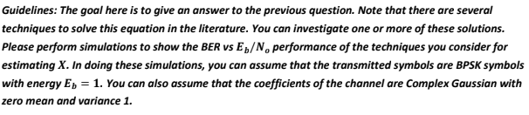
Part 2 : Inter-Symbol Interference due to Multi-Path Channels

Slide 24
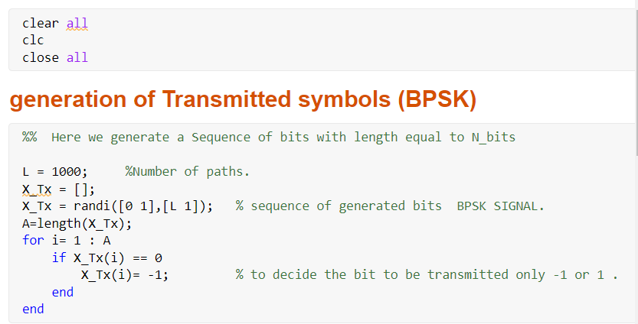
Part 2 : Inter-Symbol Interference due to Multi-Path Channels
%%Here, Transmitted (X) is random sequence of {0,1} then convert it to BPSK (bipolar) to {-1,1}

Slide 25
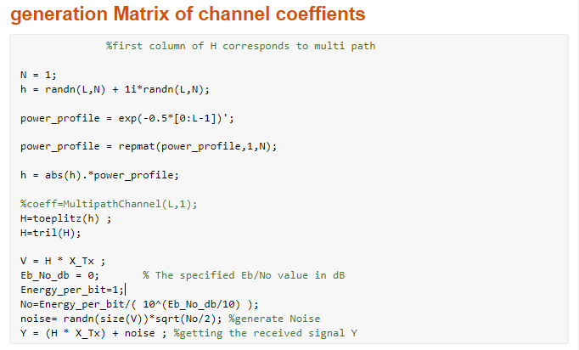
Part 2 : Inter-Symbol Interference due to Multi-Path Channels
%%Generation of Channel effect coefficients of paths (h) and whole Effect matrix H
%%

Slide 26
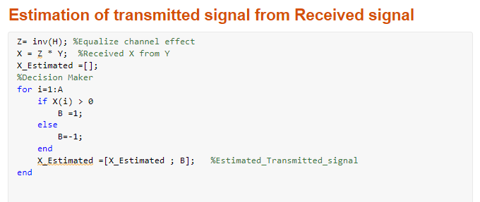
Part 2 : Inter-Symbol Interference due to Multi-Path Channels
%%Here, we estimate Transmitted (X_Estimated) signal from Received Signal (Y) then convert it to be polar digital {-1,1} %%

Slide 27
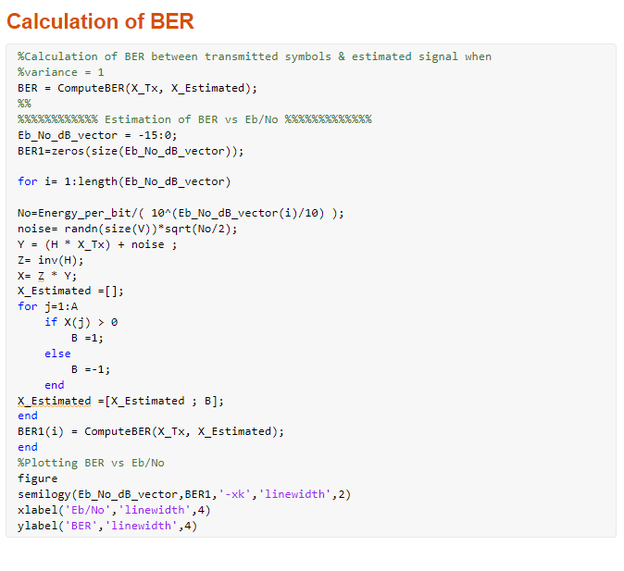
Part 2 : Inter-Symbol Interference due to Multi-Path Channels

Slide 28
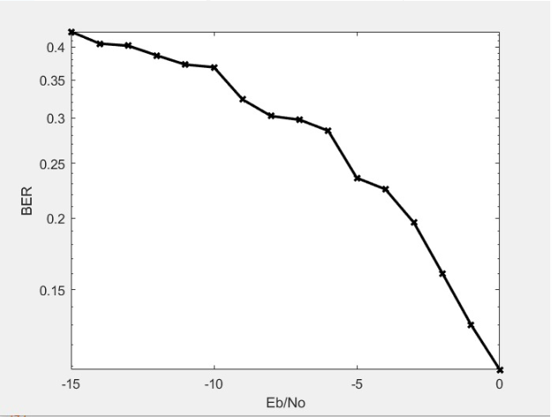
Part 2 : Inter-Symbol Interference due to Multi-Path Channels
BER Representation

Slide 29
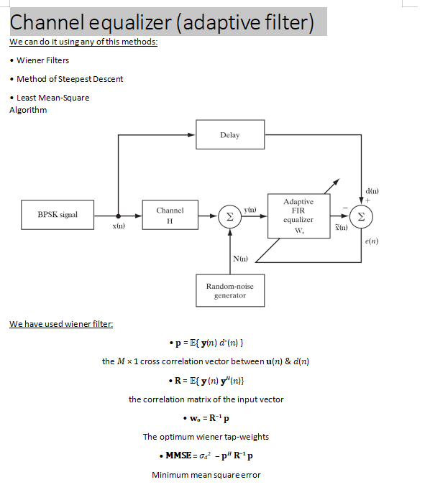
Another method : Wiener filter

Slide 32
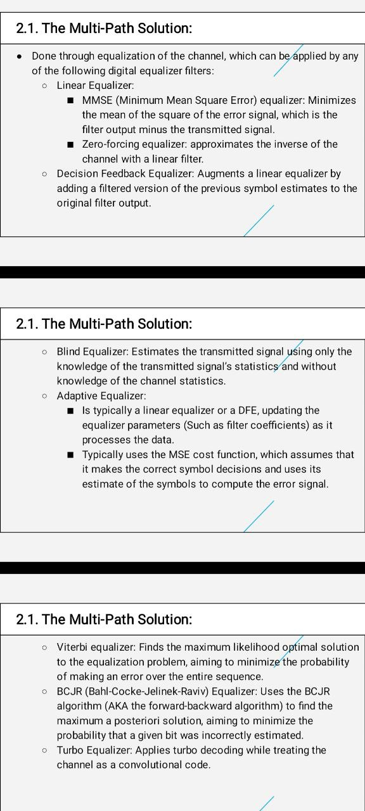

Slide 35
Part 3 : Comparison of coding Techniques

Slide 36
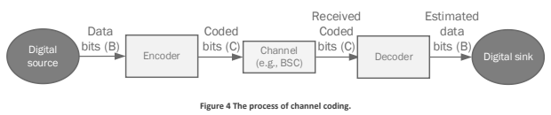

Part 3 : Comparison Coding Techniques

Slide 37
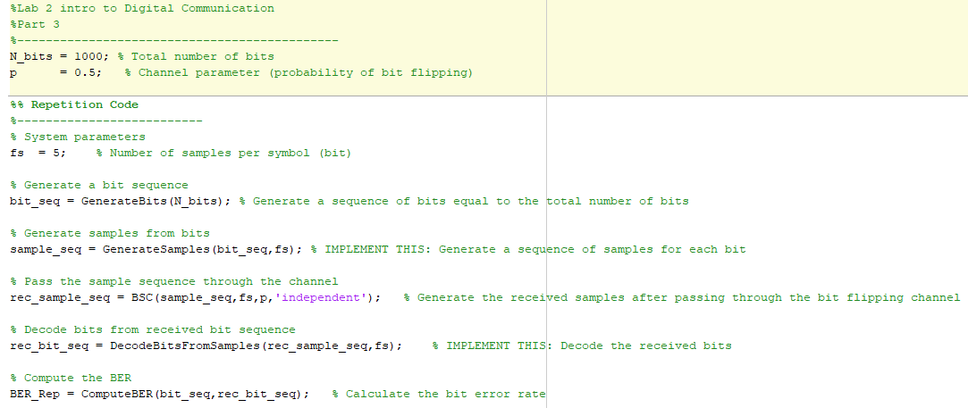
Part 3 : Comparison Coding Techniques
Repetition Code Main Script
Steps :
1-Generate bits
2-Generate sequence of samples for each bit
3- Generate the received samples after passing through (Bit flipping channel)
4-Decode received bits then get BER

Slide 38
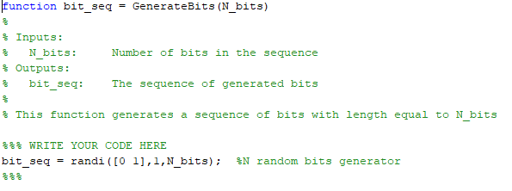
Part 3 : Comparison Coding Techniques
Generate Bits Function

Slide 39
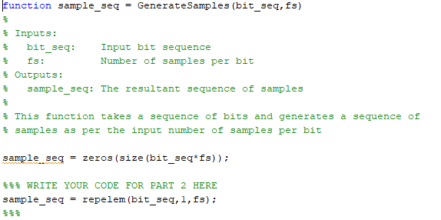
Part 3 : Comparison Coding Techniques
Generate Samples Function (Encoder)

Slide 40
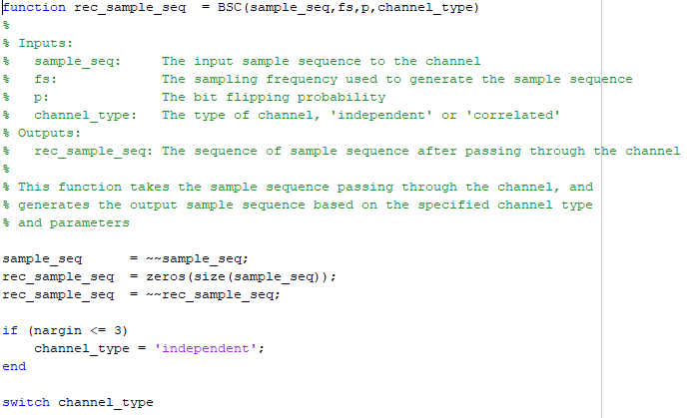
Part 3 : Comparison Coding Techniques
BSC channel Function

Slide 41
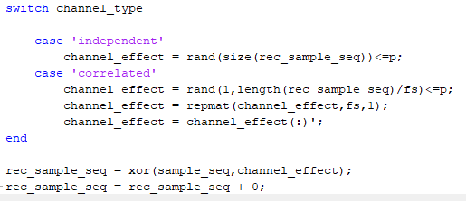
Part 3 : Comparison Coding Techniques
BSC channel Function (Cont.)

Slide 42
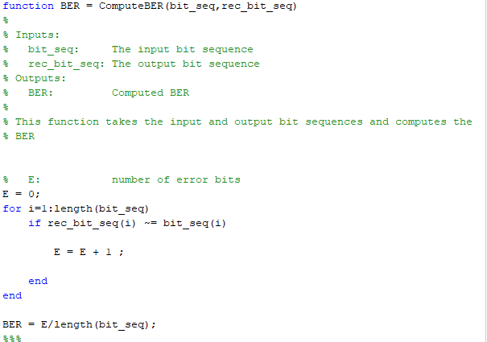
Part 3 : Comparison Coding Techniques
BER Computation for Repetition Code

Slide 43
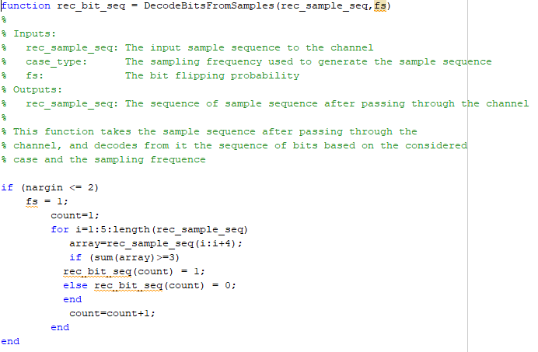
Part 3 : Comparison Coding Techniques
Decoder of Repetition code

Slide 44
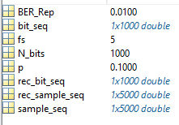
Part 3 : Comparison Coding Techniques
Results @ P = 0 .1

Slide 45
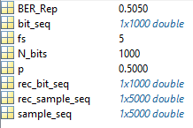
Part 3 : Comparison Coding Techniques
Results @ P = 0 .5
So, if we increase the probability of flipping of the channel then Bit error rate increases until 0.5 at p = 0.5

Slide 46
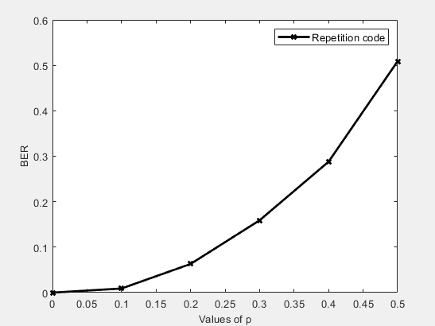
Part 3 : Comparison Coding Techniques
BER representation of Repetition code

Slide 47
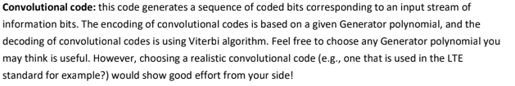
Part 3 : Comparison Coding Techniques
Convolutional code

Slide 48
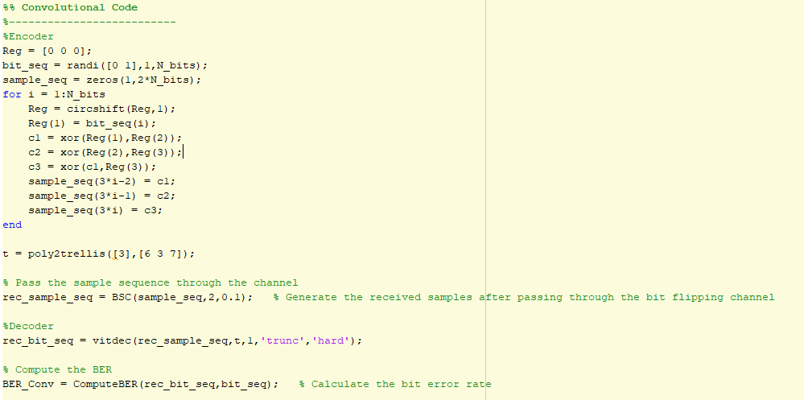
Part 3 : Comparison Coding Techniques
Convolutional code main script (Encoder and Decoder)

Slide 49

Part 3 : Comparison Coding Techniques
Results @ P = 0 .1
BER = 0.0740

Slide 50

Part 3 : Comparison Coding Techniques
Results @ P = 0 .5
BER = 0.4980
So, if we increase the probability of flipping of the channel then Bit error rate increases until 0.5 at p = 0.5

Slide 51

Part 3 : Comparison Coding Techniques
BER representation of Repetition code

Slide 52

Part 3 : Comparison Coding Techniques
For Reliability sequence , The values ordered from worst to best in matrix 1 x 1024

Slide 53


Part 3 : Comparison Coding Techniques
Steps
1-Generating an input of a random sequence of K bits
2-Generating frozen bits from reliability sequence equal to (N-K)
3-generating Generator Matrix (G2) with size 2x2
4-Generating (G) by polar transformation (G2 with every previous G) ((kronecker product))
5-Encoding Input signal by polar transformation

Slide 54

Part 3 : Comparison Coding Techniques

Slide 55

Part 3 : Comparison Coding Techniques

Slide 56

Part 3 : Comparison Coding Techniques
BER representation of Polar code

Slide 57

Part 3 : Comparison Coding Techniques
BER representation of three curves at same plot

